Slide 1
Demographic Research
For Crisis

Slide 2
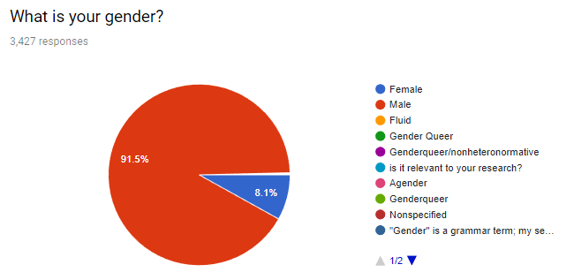
Gender Spread - Stonemeier Games

Slide 3
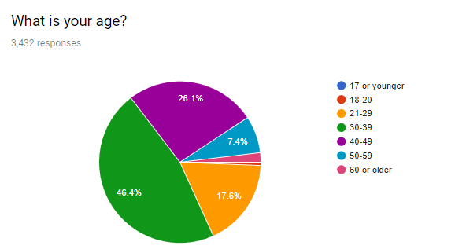
Age Spread - Stonemeier

Slide 4
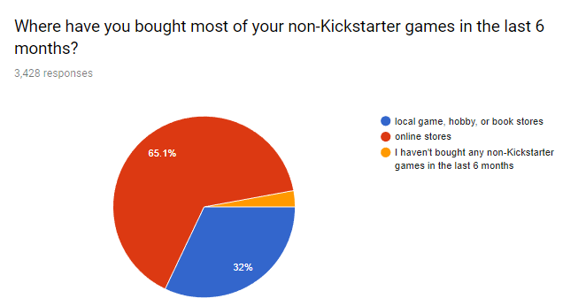
Where games purchased - Stonemeier

Slide 5
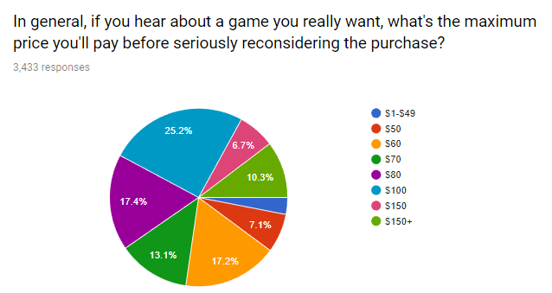
Price - Stonemeier
Stonemeier Games. (2017). 5 Surprises from Our Demographic Survey. Available: https://stonemaiergames.com/5-surprises-from-our-demographic-survey/. Last accessed 11th March 2018.

